Slide 1
Search for Gravitational Waves with Interferometric Detectors
Chairs: Qi Chu (UWA) and Karl Wette (ANU)
LIGO-Virgo searches led by OzGrav members
SPIIR CBC search pipeline preparations for O3
(Qi Chu, Joel Bosveld, Linqing Wen and others, UWA)
BayesWave burst search pipeline, O1 and O2 all-sky burst search paper
(Meg Millhouse, UniMelb)
CW O2 Sco X-1 Viterbi 2.0 search
(Patrick and others,, UniMelb)
Stochastic group O2 directional searches
(Pat Meyers, UniMelb; Boris Goncharov & Colm Talbot, Monash)
OzGrav participation/contribution to LIGO-Virgo searches
Long-duration post-merger search
(Lilli, Andrew, Paul, Nikhil, others; UniMelb+Monash)
OzGrav activities
CW workshop Aug. 2018
Organised by Karl Wette
OzStar task force
(Karl Wette, Qi Chu)

Slide 2
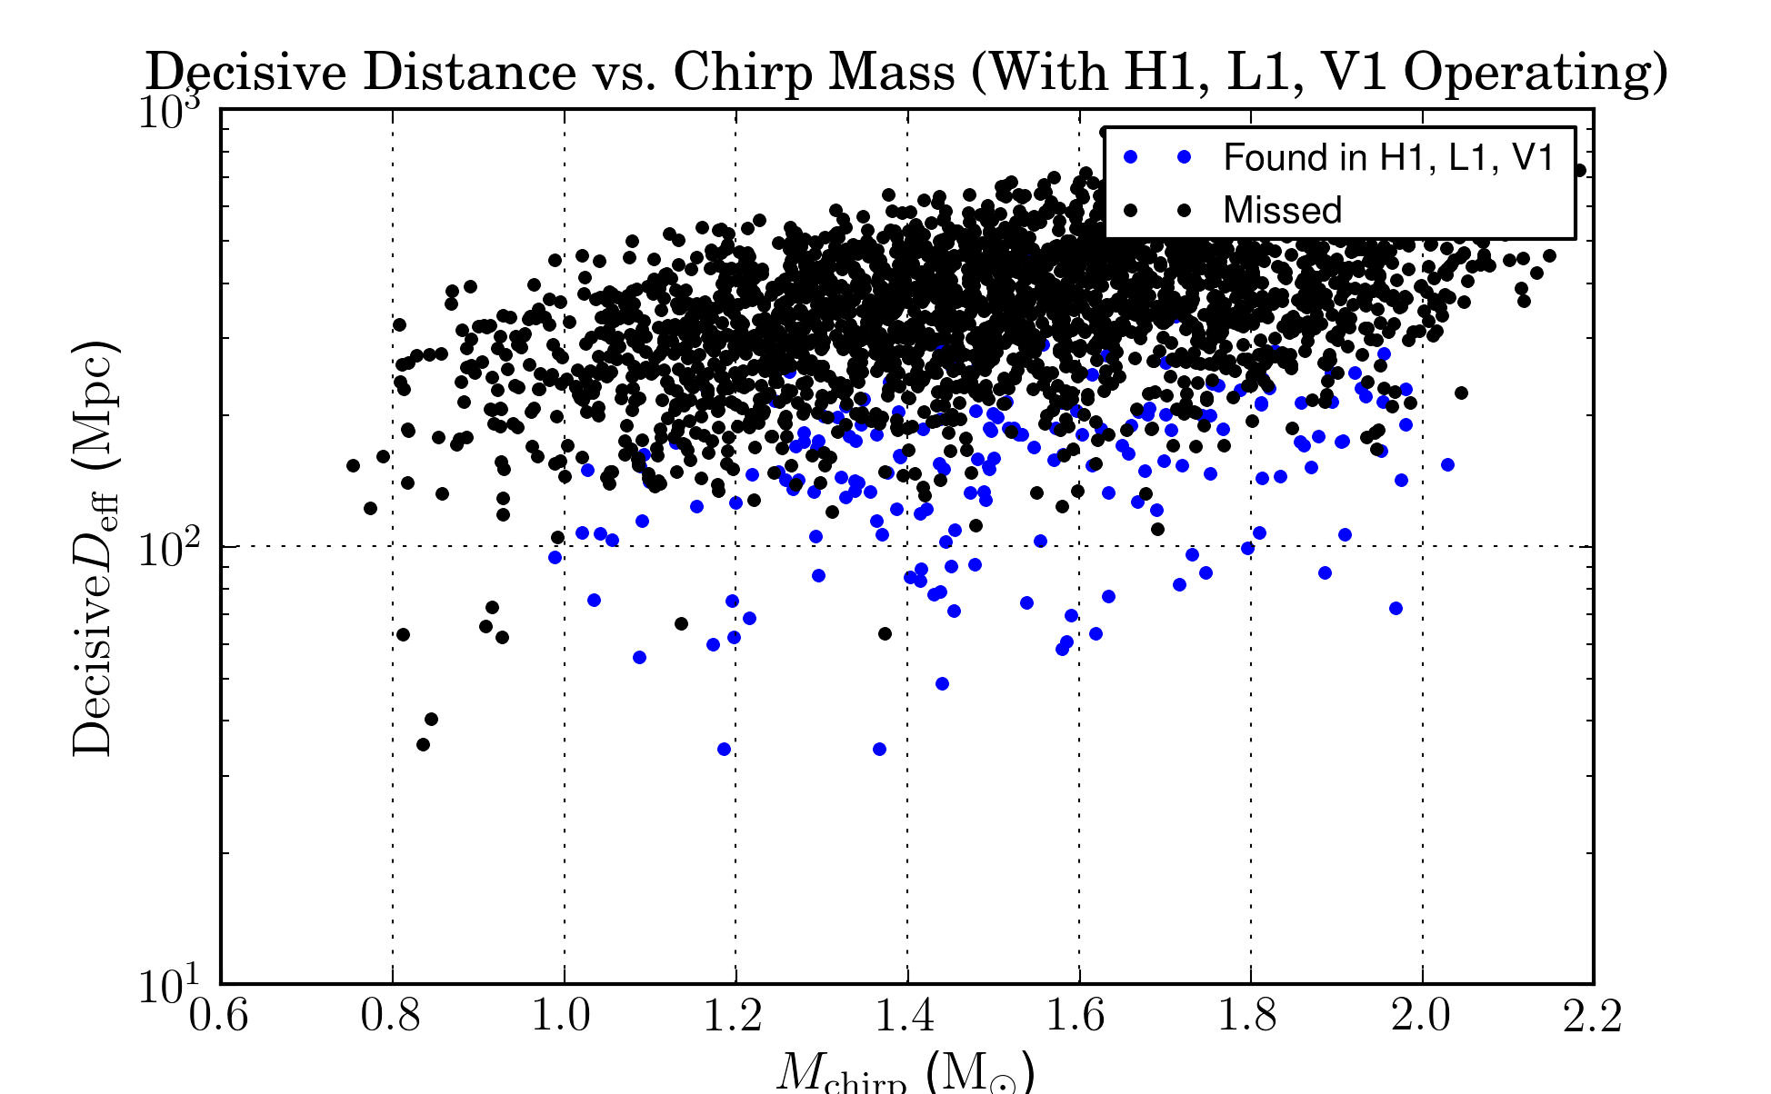
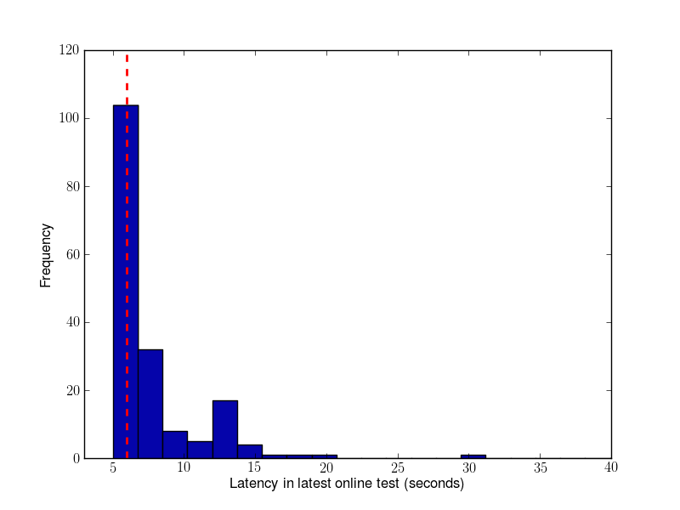
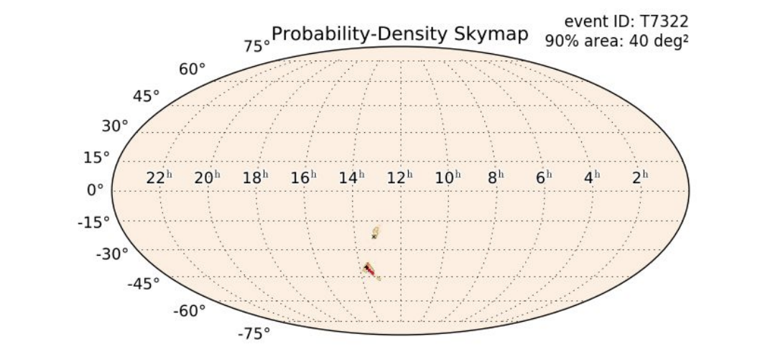
SPIIR Online CBC Search pipeline -- preparation for O3
Online search performance:
Sensitivity of mock O2 online tests
High-significance glitch triggers down to zero
Latency from 20 seconds down to 6 seconds
Prompt skymap uploading

Slide 3
SPIIR Online CBC Search pipeline
Aiming for first NSBH !
O3 search plan:
Search for BNS, NSBH, and BBH
Online triggers with HLV (and HL if quality of Virgo data is unsatisfying), with prompt skymaps
Online triggers with HLVK when KAGRA data is usable (subject to review)
Preparation for ER13/ER14/O3:
Code review: pass milestones with online HLV analysis
Officially documented as one of the online CBC pipelines in O3 EM followup userguide
First round of SPIIR O3 readiness document circulated
Computing resources allocated for SPIIR online runs
Point persons for O3 operation: Qi Chu and Linqing. Manoj and Xiaolin, 2 PhDs, are being trained for O3 operation and follow up events. More persons welcome.
Ongoing and future work:
Incorporating KAGRA data processing
SPIIR catalog on O1 and O2 data
SPIIR search of sub-threshold events with FRB triggers.

Slide 4
BayesWave burst search
Bayesian reconstruction of unmodeled GW bursts using sine-Gaussian wavelets
Online follow-up of coherent wave-burst search
Robust distinction between signals and glitches
Waveform reconstruction with minimal assumptions on souce
Preparation for O3:
Continue to run as on online follow-up
No major changes between O2 and O3
Ongoing and future work
O2 short-duration burst search paper nearly done
See O1 All Sky Paper for reference: arxiv:1611.02972
Planned O3 paper with results from taht run

Slide 5
CW O2 Sco X-1 Viterbi 2.0 search
Search for continuous gravitational waves from the low-mass X-ray binary Scorpius X-1
The Viterbi 2.0 search pipeline builds on two techniques:
a hidden Markov model (solved by the Viterbi algorithm), which makes the search robust against spin wandering: that is, unpredictable stochastic variation in the GW frequency
the J-statistic: a matched filter that fully accounts for the motion of the source neutron star in its binary orbit
Will be published before the O2 data release in Feb 2019
Ongoing and future work, O3 plans
Will re-run Sco X-1 search on full O3 dataset
Aim to do a search for LMXBs other than Sco X-1
GPU version of the core algorithm exists, produces the right results, runs super-fast
Working on sensitivity improvements for the hidden Markov model

Slide 6
Stochastic O2 directional searches
Search over persistent narrowband gravitational wave point-sources in 20-1726 Hz band at directions of Scorpius-X1, SN1987A and Galactic Center.
Search for gravitational wave point sources with a broadband spectrum over all sky locations.
Search for extended in space sources of gravitational waves using spherical harmonics decomposition.
O3 detection possibility and preparation
Possibility of a low-significance detection of an isotropic stochastic background in O3
Unknown possibility of isolated, narrowband sources, Sn1987a and Galactic centre
ScoX-1, sensitivity unlikely to reach torque-balance limit in O3
Ongoing and future work
Finish and publish O2 results

Slide 7
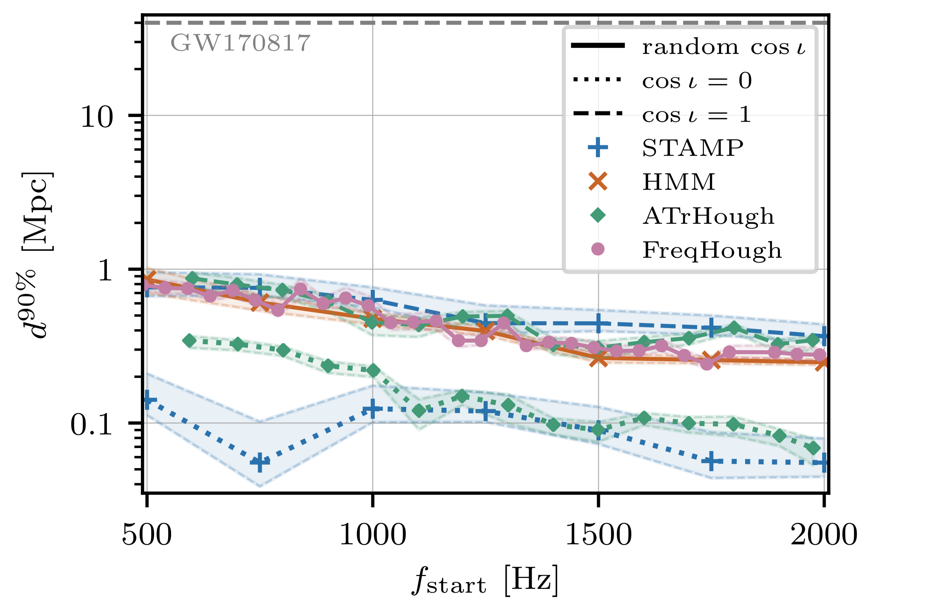
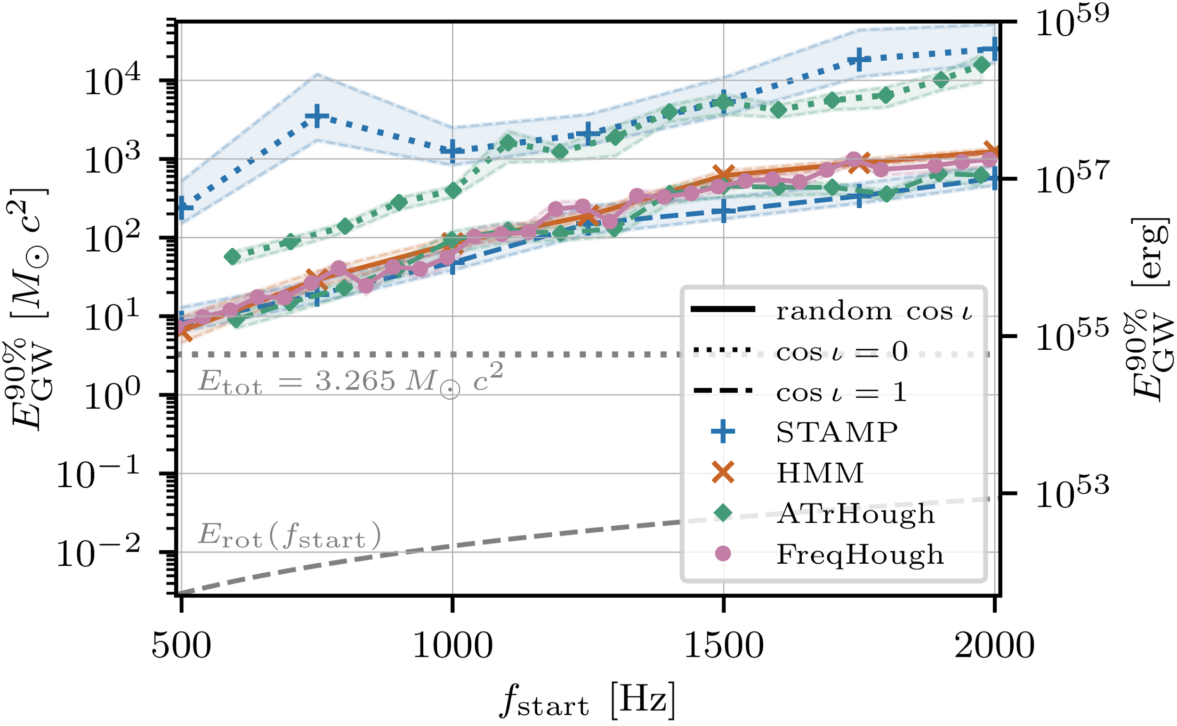
Long-duration post-merger searches
Search & Sensitivity (arXiv:1810.02581)
Two unmodeled algorithms
Two model-based algorithms (power-law model)
Up until the end of O2; no detection claimed
Detectors with lower noise level are needed
Beyond detectability even with optimal matched filter
O3 detection possibility and preparation
Methods are ready for future analysis
Working on improvement of the methods, e.g., hidden Markov model tracking of cross-power map, using 3 IFOs, etc.
Not likely to have detection in O3

