Slide 1
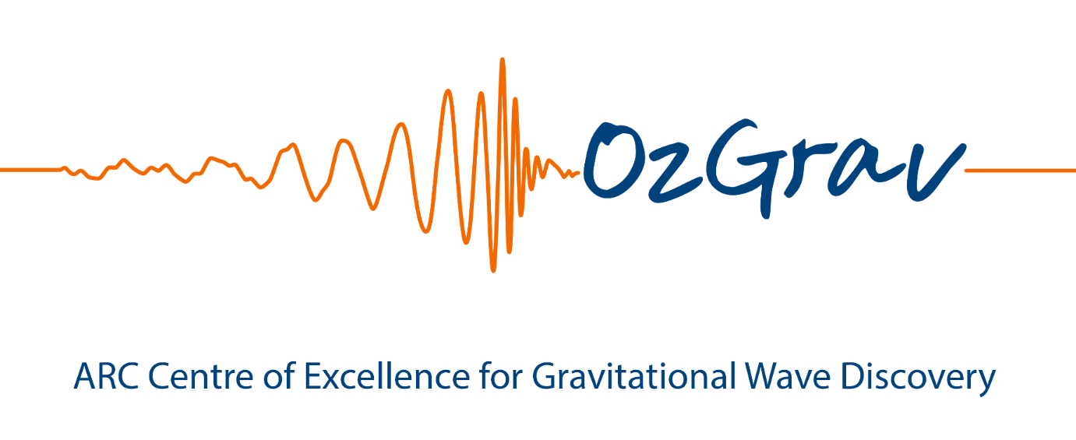








OzGrav High Frequency Detector – Detector Design
David Ottaway for HF Working Group

Slide 2
Introduction
Detector design progress to date
Critical Issues
  Coating Thermal Noise
  Interferometer Length
  High Circulating Power
  Cryogenics

Slide 3
The detector
How can we build a detector that is fundable that can make a real difference to the global network?
Noise sources at HF generally simpler – mainly a light measurement problem
  ie displacement noise sources not so important
  Length not as critical – can be achieved by folding
  Require extremely high power though (5 MW)
Building a vacuum system from scratch give us advantage
Cost $50 M - $100 M less may be more fundable
Proposed GEO HF Detector Noise Prediction, Denis Martynov et al.

Slide 4
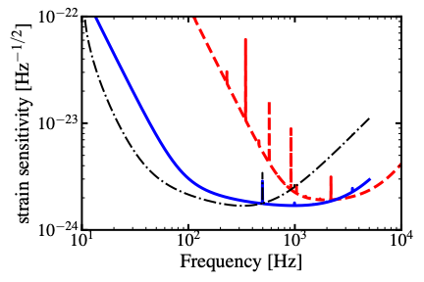
Why we should focus on just HF
Cheap and Effective
Really stiff suspensions prevent Siddles Sigg Instabilities
Can use powerful actuators for length/alignment control with high bandwidth
Significant folding to reduce length of vacuum pipes
Minimal commissioning time
Low Frequency adds significant cost and complexity
Displacement noise sources become important
Auxiliary control noises become really important
Low Frequency Covered by three other longer detectors that have significantly bigger budgets – aLIGO+ and Virgo+

Slide 5
Key Issues
• Report on 23K vs 123K (TBD)
• OzMO Decision tree (David O, Rob W, Paul L and Eric T)
• Niobium suspensions or something else? (Joris and Peter V)
• Limitations from Kapitza resistance? (Joris)
• Signal recycling cavity very long cavity vs detuning (Dan B, Dave O and Rob W)
• Float zone silicon? (TBD)
• Suitable pipe diameter; pipe scaling laws (David B)
• Benefits/Risks of Folding (Dave O)
• Cost function (TBD)
Risks with high circulating power
Is laser frequency noise going to be an issue?

Slide 6
Design Studies/Talks to Date
Initial Strawman Design given by Rob Ward
  Virtuous cycle of going to 20k
  Similar to Dan Martynov, 10 MW at 20 k
Vacuum system discussion by David Blair
  Need at least 1m diameter
  Vacuum Pipe ~$2k/m => $4M for 1 km arm detector
Suspension/Seismic Isolation by Joris van Heijningen
Cryo materials by Joris van Heijningen/Peter Veitch
Angular instabilities at high power by Liu Jian – Risk retired – just check noise
Optimum test mass designs for minimising parametric instabilities by Zhang Jue,
GW Polarization discussion by Paul Lasky
Importance of HF by Paul Lasky
Bilby/Pygwinc by Dan Brown

Slide 7
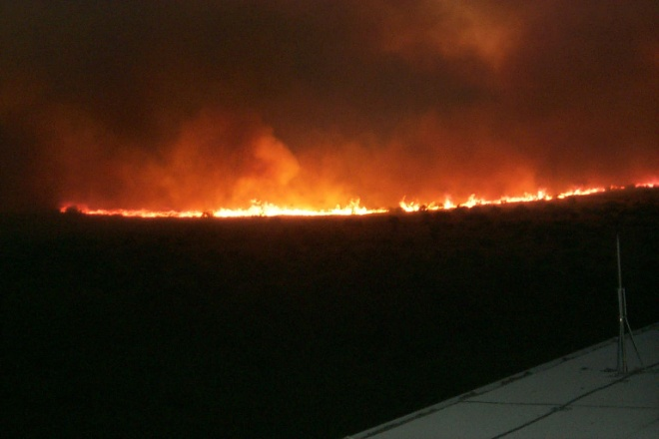
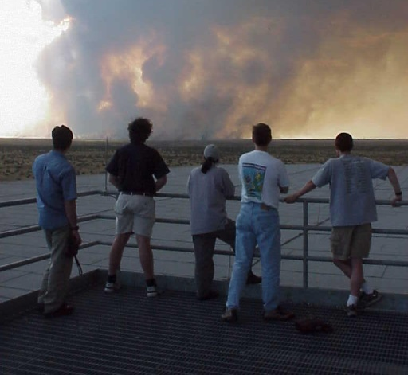
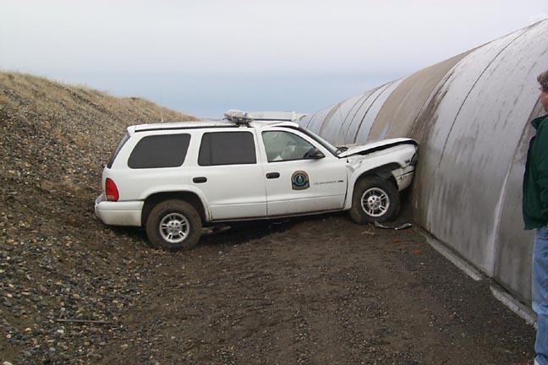
Beam Tubes Covers are important do we need them?

Slide 8
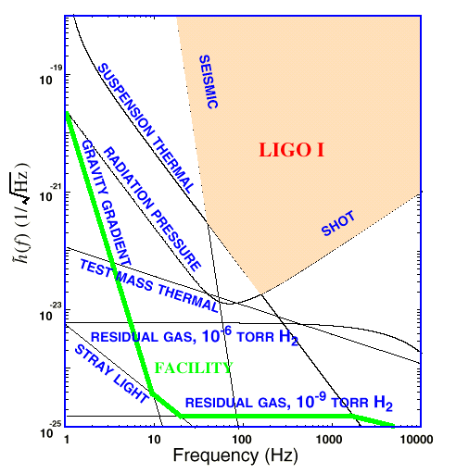
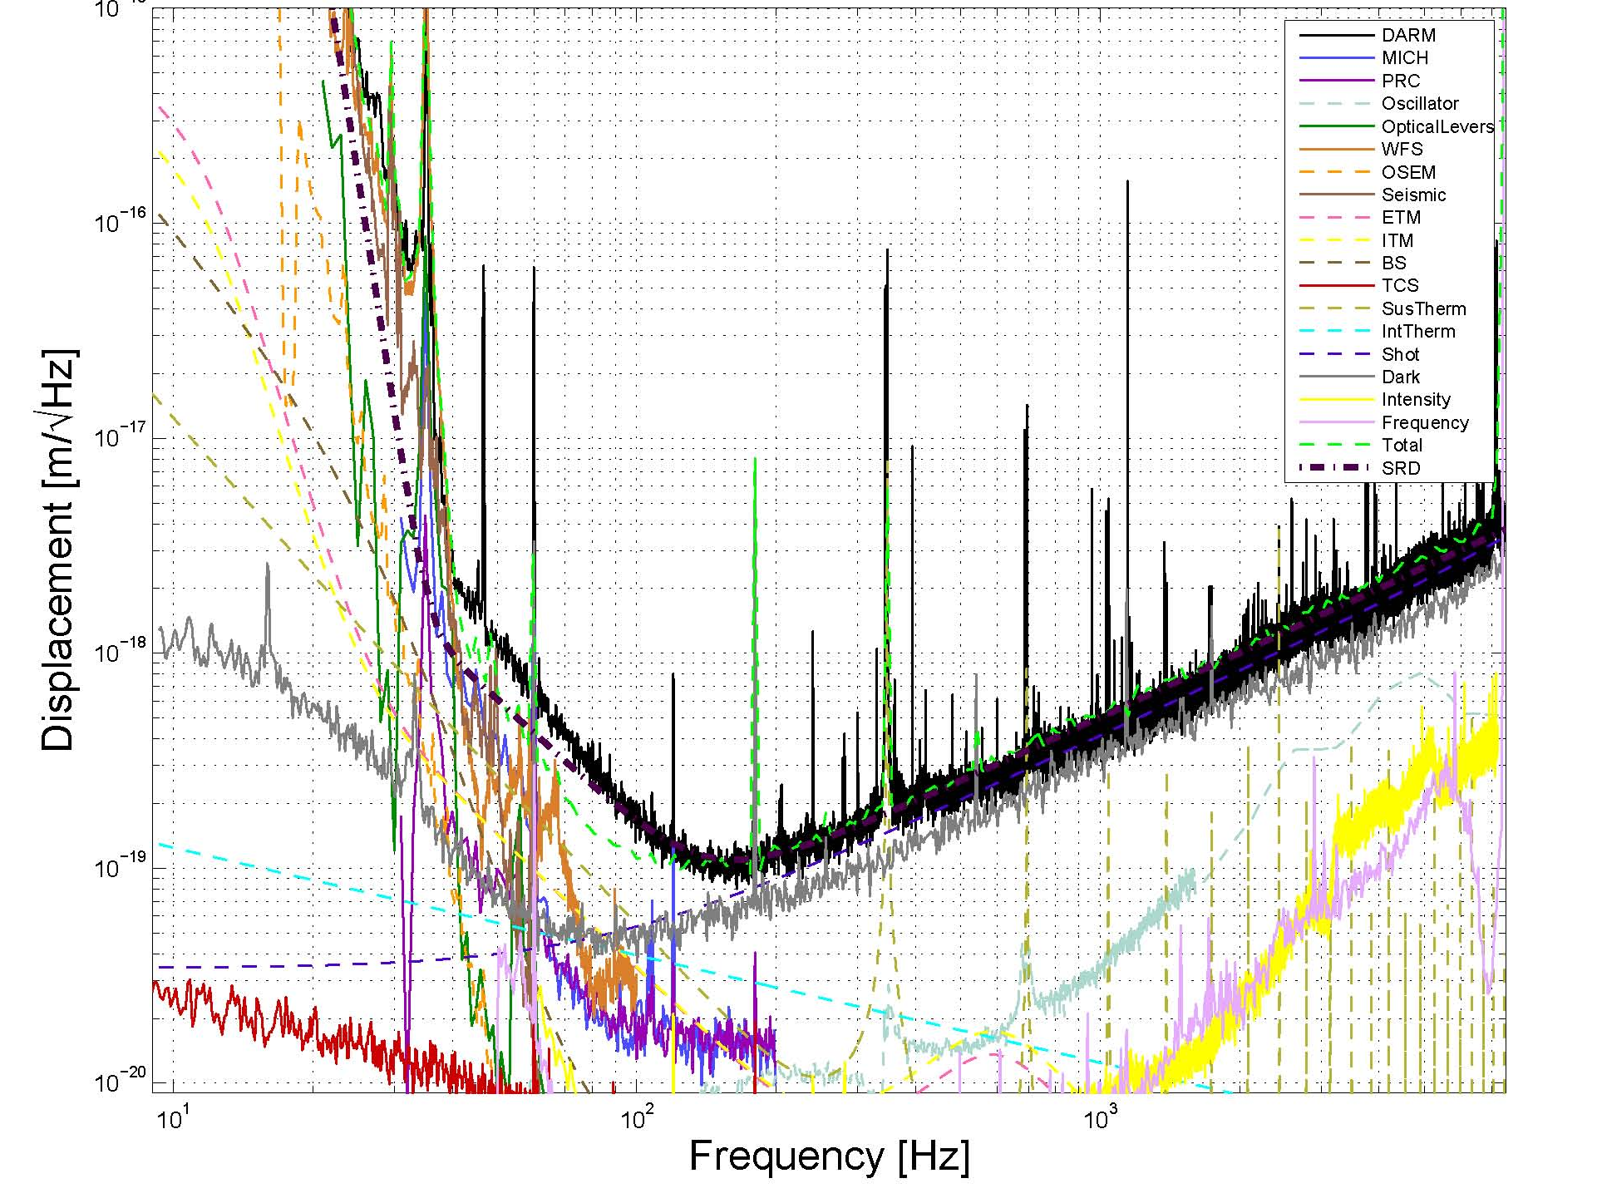
A perspective on HF Noise sources – Initial LIGO
Large power actuators probably OK
iLIGO Seismic and Suspension would suffice in Signal Band – Possibly not in control band

Slide 9
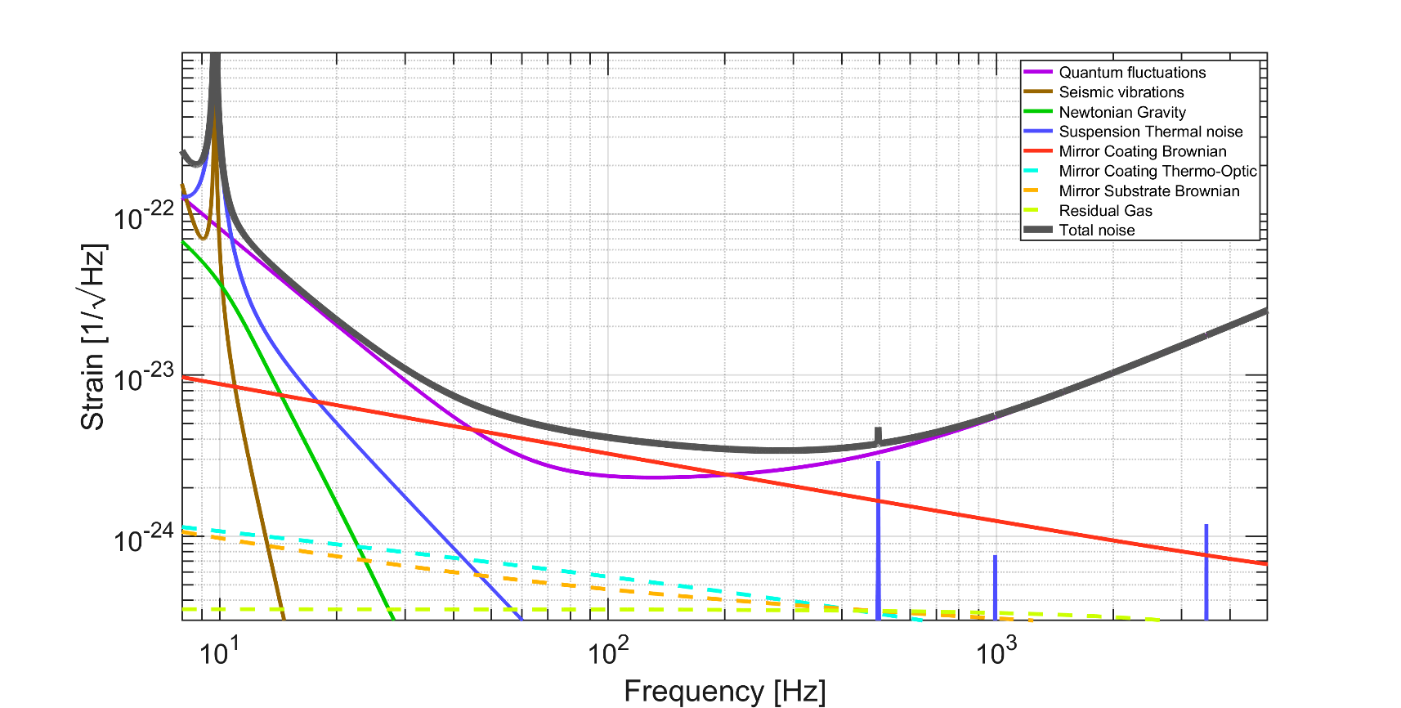
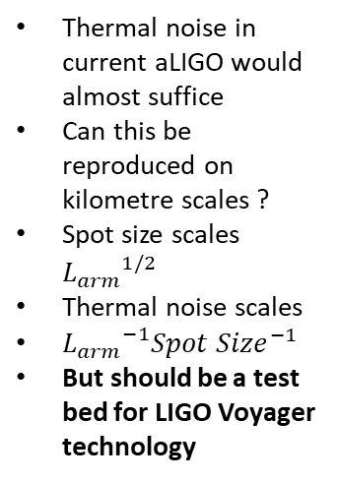
Thermal Noise for aLIGO
Thermal noise in current aLIGO would almost suffice
Can this be reproduced on kilometre scales ?
Spot size scales ${L_{arm}}^{1/2}$
Thermal noise scales
${L_{arm}}^{−1}{Spot Size}^{−1}$
But should be a test bed for LIGO Voyager technology

Slide 10
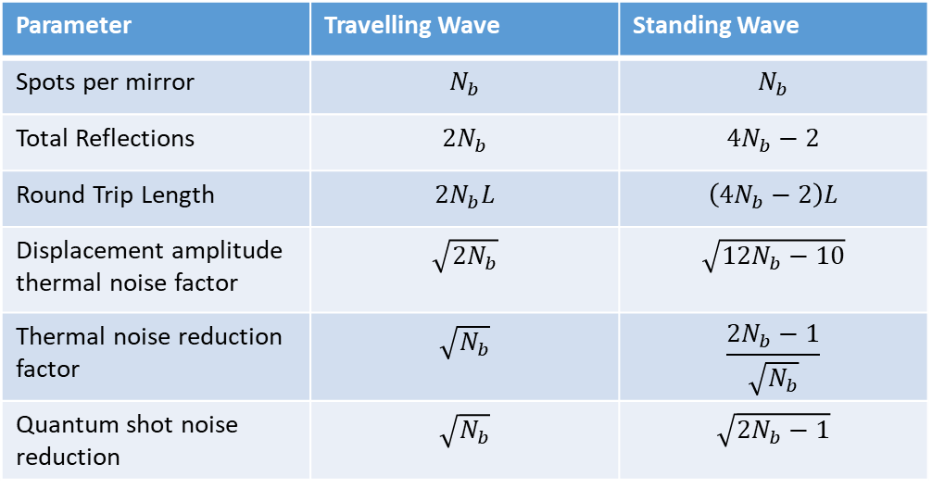
A First Look of Folding OzGrav HF
Sensitivity in quantum noise dominated regime proportional to sqrt( Total Arm Length) – Regardless of Folding
Coating Thermal Noise Scales inversely proportional to:
Spot size x bounce length x bounce factor
Parameter | Travelling Wave | Standing Wave
Spots per mirror | $$N_{b}$$ | $$N_{b}$$
Total Reflections | $${2N}_{b}$$ | $${4N}_{b}−2$$
Round Trip Length | $${2N}_{b}L$$ | $$\left({4N}_{b}−2\right)L$$
Displacement amplitude thermal noise factor | $$\sqrt{{2N}_{b}}$$ | $$\sqrt{{12N}_{b}−10}$$
Thermal noise reduction factor | $$\sqrt{N_{b}}$$ | $$\frac{{2N}_{b}−1}{\sqrt{N_{b}}}$$
Quantum shot noise reduction | $$\sqrt{N_{b}}$$ | $$\sqrt{{2N}_{b}−1}$$

Slide 11
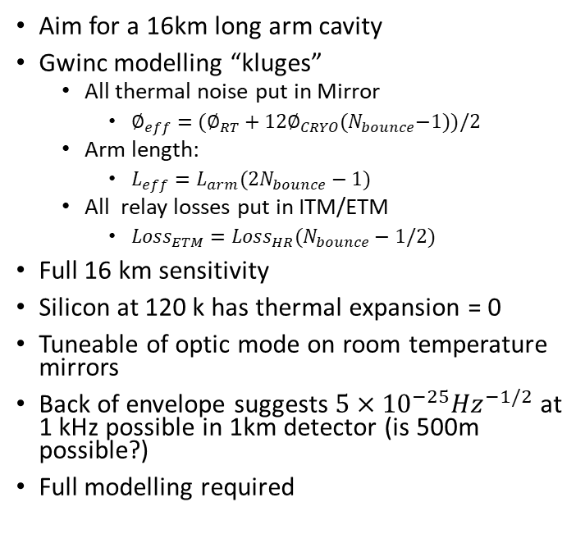
Proposed Folded Cavity for OzGrav HF
Tuneable room temperature suspended mirrors
Aim for a 16km long arm cavity
Gwinc modelling “kluges”
  All thermal noise put in Mirror
    $∅_{eff}=(∅_{RT}+{12∅}_{CRYO}{(N}_{bounce}−1))/2$
  Arm length:
    $L_{eff}={L_{arm}(2N}_{bounce}−1)$
  All relay losses put in ITM/ETM
    ${Loss}_{ETM}={{Loss}_{HR}(N}_{bounce}−1/2)$
Full 16 km sensitivity
Silicon at 120 k has thermal expansion = 0
Tuneable of optic mode on room temperature mirrors
Back of envelope suggests $5×{10}^{−25}{Hz}^{−1/2}$ at 1 kHz possible in 1km detector (is 500m possible?)
Full modelling required
Cryo cooled mirrors hopefully 120 k similar coatings to Voyager

Slide 12
Possible Breakout Sections Topics
20K vs 123K ?
Benefits/Risks of Folding ?
What is the optimum vacuum length or how short can we get away with?
Parametric Instability Issues at 10MW - Solutions
Risks with high circulating power?
OzMO Decision tree

