Slide 1
STORIES IN THE WAVES
Exploring the Electromagnetic Spectrum (with a Gravitational Wave Bonus)

Slide 2
The next slides show images of the SAME region of sky, but using different types of light

Slide 3
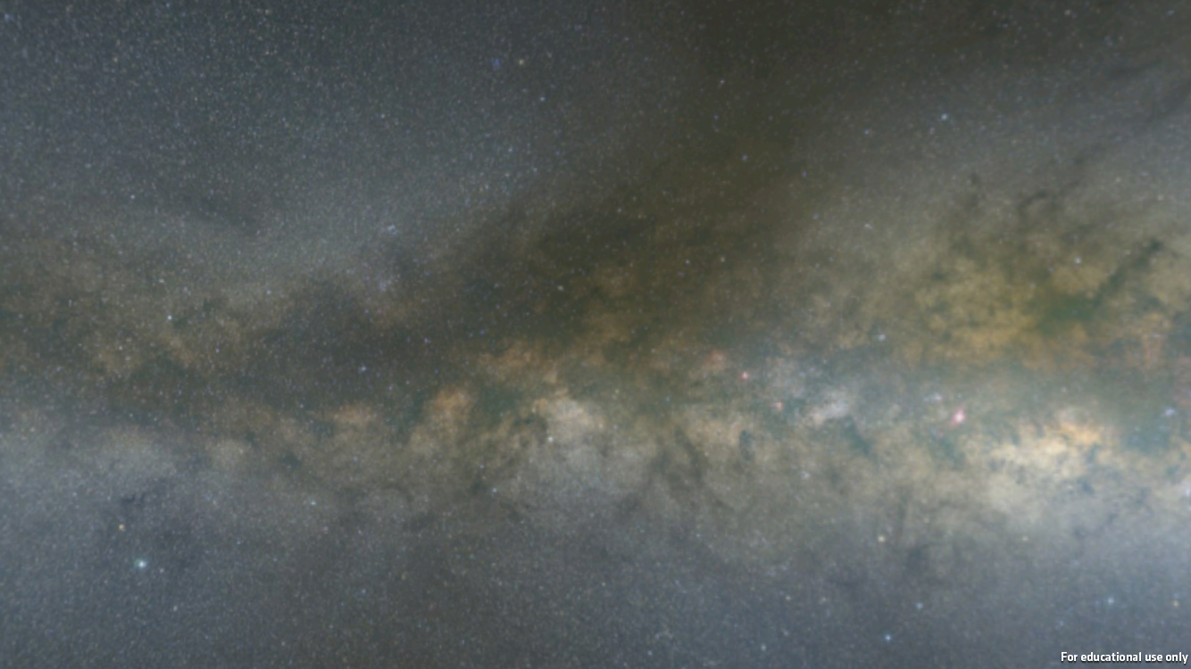
The view in VISIBLE LIGHT

Slide 4
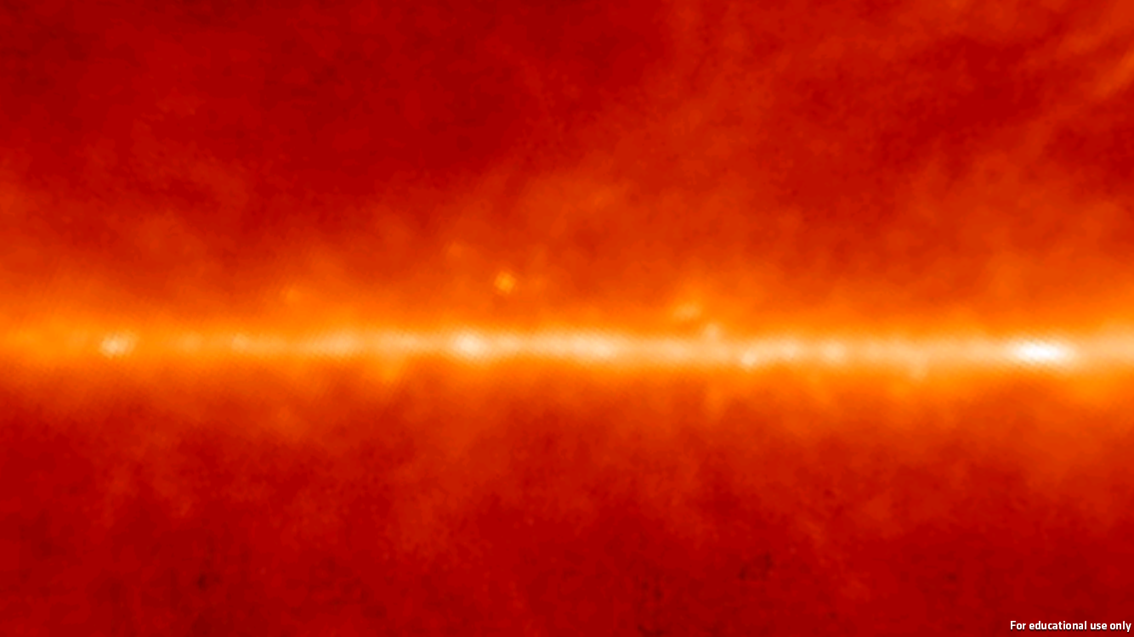
INFRARED

Slide 5
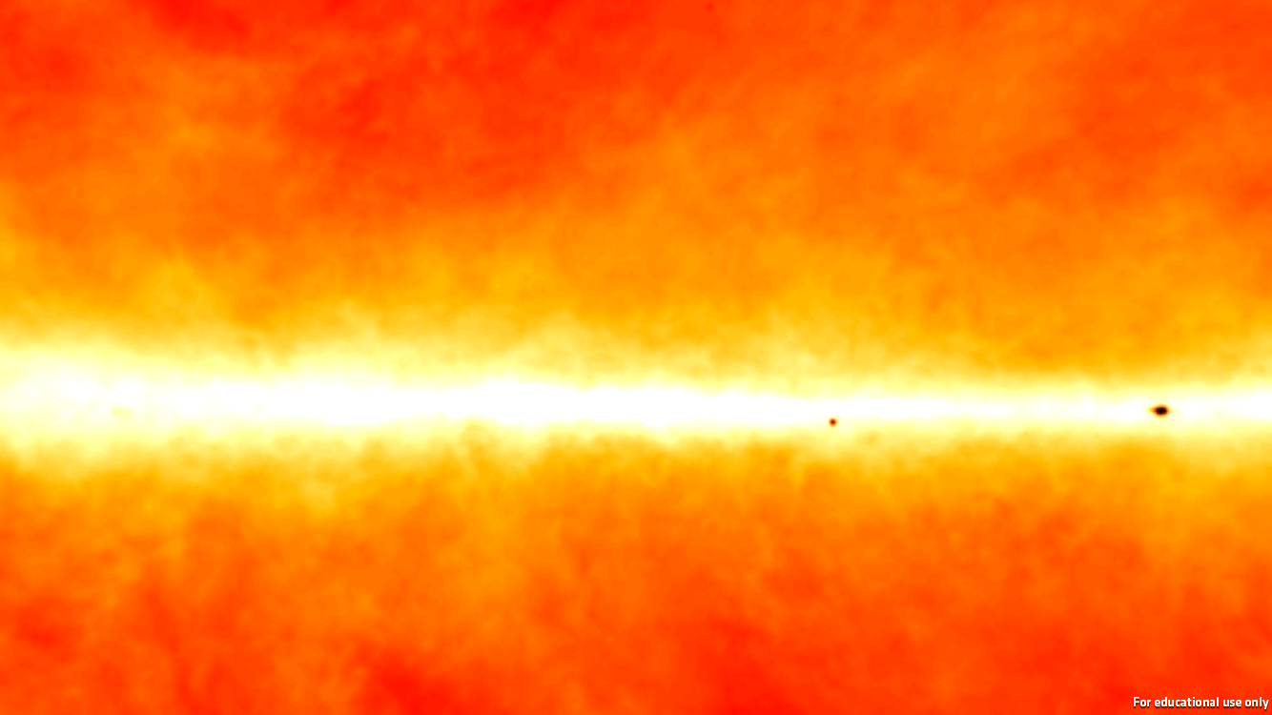
RADIO WAVES

Slide 6
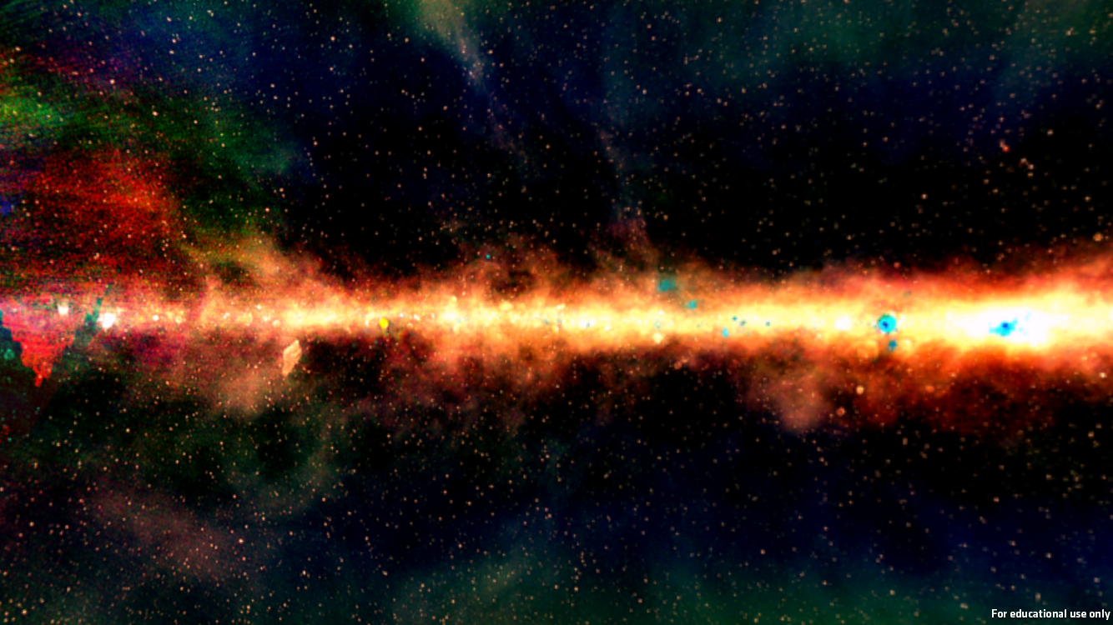
RADIO WAVES

Slide 7
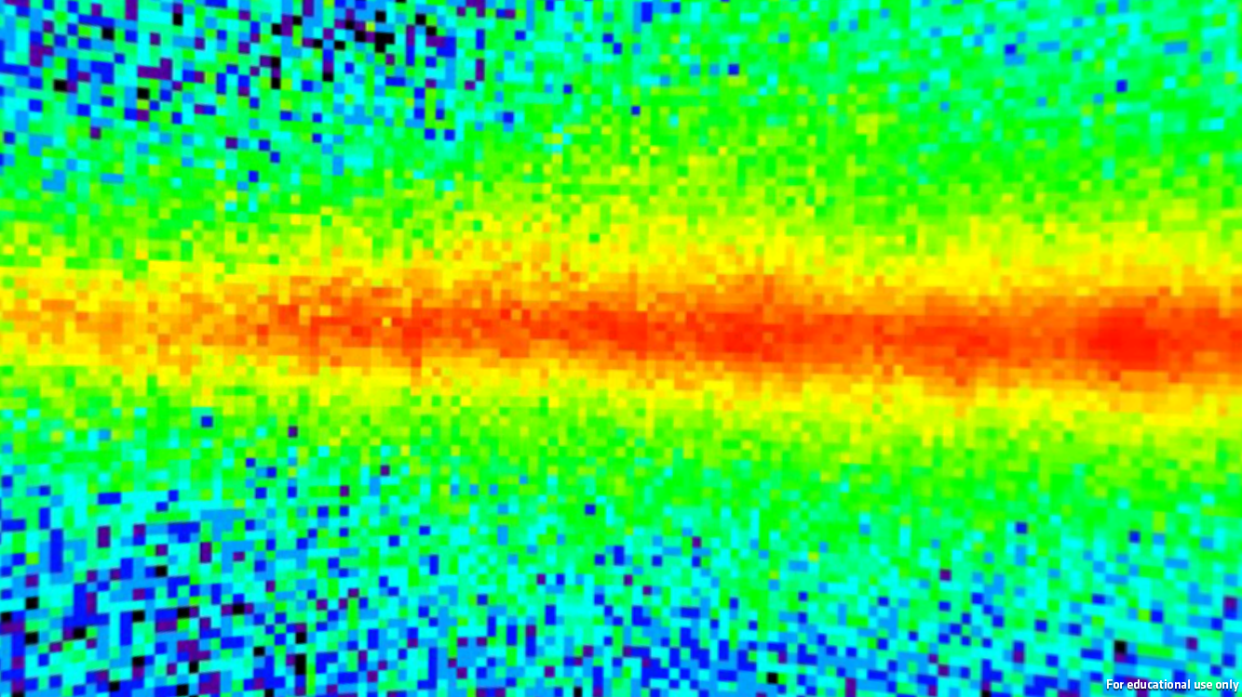
GAMMA RAYS

Slide 8
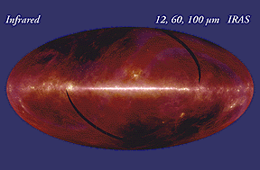
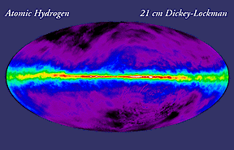
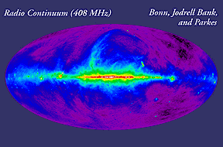
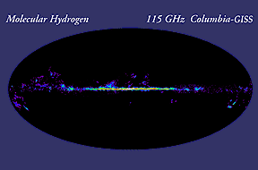
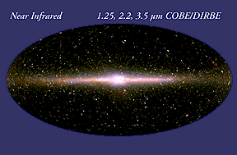
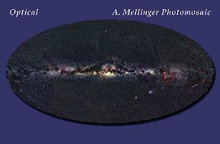
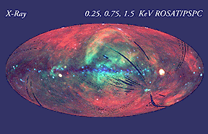
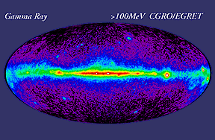
Different types of light give us different information!
Notes:
SOURCE: http://mwmw.gsfc.nasa.gov/mmw_allsky.html

Slide 9
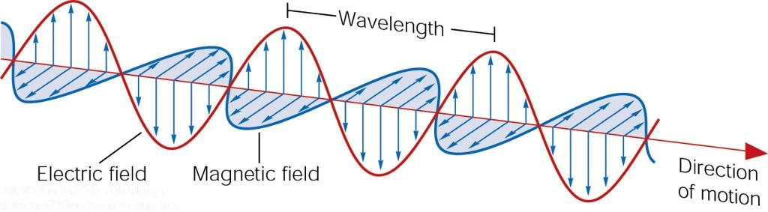
But what IS light?
It’s “ELECTROMAGNETIC RADIATION”
Normally we think of visible light, but there are lots of types of light that are all produced by accelerating charged particles (basically “wiggling”).

Slide 10
Electromagnetic radiation
This “wiggling” creates a changing ELECTRIC
FIELD and MAGNETIC FIELD
The resulting “electromagnetic wave” propagates through space

Slide 11
Electromagnetic Radiation
Oscillating waves have certain properties:
  Wavelength (λ) – the length over which the wave repeats in pattern (meters).
  Frequency (f) – how often the wave repeats itself (cycles per second).
Speed = wavelength x frequency.
For light in a vacuum, this speed is constant (c = λf = 3 x 10⁸ m/s).
λ
Frequency
1
4
2
6
5
3
7
λ
1
4
2
6
10
11
12
13
14
15
16
17
18
19
20
5
3
7
8
9

Slide 12
Light as a Particle
Light can also behave like a particle. We call the particle-like aspect of light a photon.
The ENERGY of a photon is INVERSELY PROPORTIONAL to its wavelength and DIRECTLY PROPORTIONAL to its frequency.
E = hc/λ
    where, h = Planck’s constant (6.626 x 10^{–34} J·s)
    c = Speed of light (3 x 10⁸ m/s)
E = hf

Slide 13
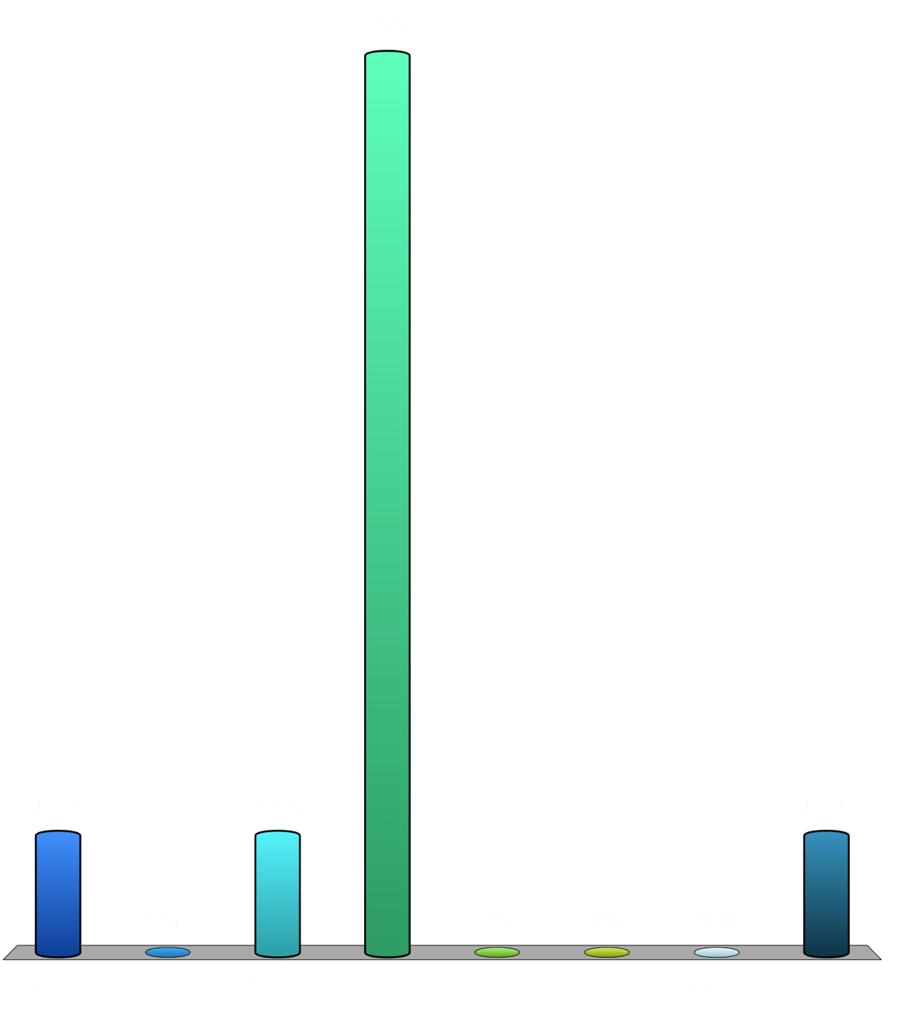
A RED photon has a _____ wavelength, _____ frequency and _____ energy than a BLUE photon.
longer, higher, greater
longer, higher, smaller
longer, lower, greater
longer, lower, smaller
shorter, higher, greater
shorter, higher, smaller
shorter, lower, greater
shorter, lower, smaller
0

Slide 14
Electromagnetic Spectrum
Wavelength (m)
3x10⁴
3
3x10⁻⁴
3x10⁻⁸
3x10⁻¹²
Infrared
Ultraviolet
Gamma rays
Radio waves
Microwaves
X-rays
(e.g.,radar)
Visible light
60 Hz
FM
(ac current)
AM
TV
TV
radio
Ch 2-6
Ch 7& up
10²
10⁴
10⁶
10⁸
10¹⁰
10¹²
10¹⁴
10¹⁶
10¹⁸
10²⁰
λ = 7.5x10⁻⁷ m
λ = 4.0x10⁻⁷ m
Frequency (Hz)
f = 4.0x10¹⁴ Hz
f = 7.5x10¹⁴ Hz
Visible Light

Slide 15

Which of the following types of electromagnetic radiation travels fastest in a vacuum?
Gamma rays
Infrared
Radio
Ultraviolet
X-rays
They all travel at the same speed
0

Slide 16
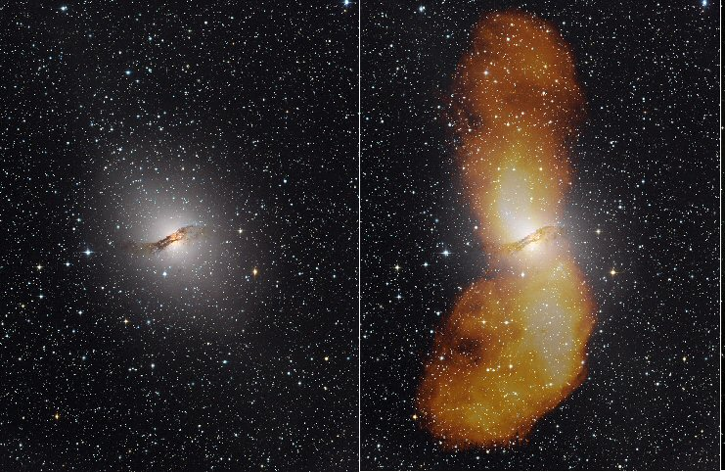
RADIO WAVES
0
Used for communication
Long wavelengths; low energy.
Here’s the irregular galaxy Centaurus A as it appears VISIBLY (left) and a composite VISIBLE + RADIO WAVES (right)
Image credit; https://svs.gsfc.nasa.gov/10770

Slide 17
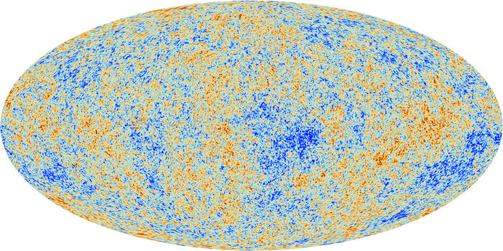
MICROWAVES
0
Used to cook and for cell phones. Mostly harmless unless specific frequency. Higher energy/shorter wavelength than radio waves.
http://www.esa.int/Our_Activities/Space_Science/Planck/Planck_and_the_cosmic_microwave_background

Slide 18
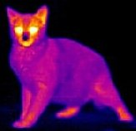
0
INFRARED LIGHT
Sometimes called “heat waves” – you can feel, but not see, this light.
What a black cat looks like in infrared wavelengths.
VERY different information!
Which parts of the cat are cool? Warm?
Image credit: http://coolcosmos.ipac.caltech.edu/image_galleries/ir_zoo/cat.html

Slide 19
More Than the Eyes Can See
The Universe in IR
http://coolcosmos.ipac.caltech.edu/videos/more_than_your/

Slide 20
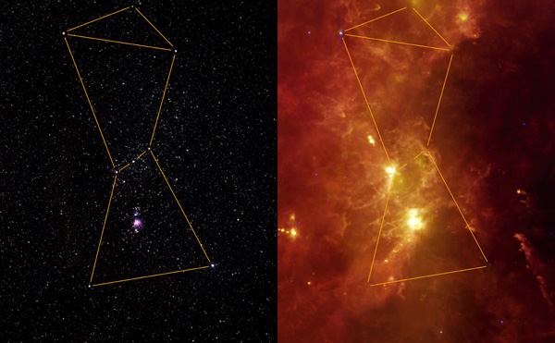
VISIBLE LIGHT
0
Detected by your eyes. Orion VISIBLY (left) and in the INFRARED (right). See how much we’re missing out on?
Image credit: https://www.nasa.gov/mission_pages/SOFIA/status_update_10-46F.html

Slide 21
WHAT YOU CAN SEE AIN’T MUCH
The Visible Inch
http://www.youtube.com/watch?v=kfS5Qn0wn2o

Slide 22
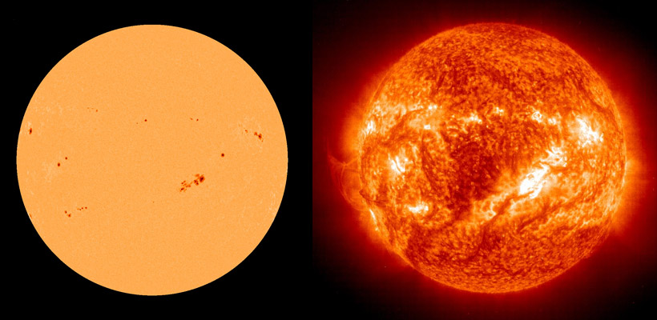
0
ULTRAVIOLET LIGHT
Energetic enough to cause sunburns! Here’s the Sun visibly (left) and in the UV (right)
Images from: https://earthobservatory.nasa.gov/images/37575

Slide 23
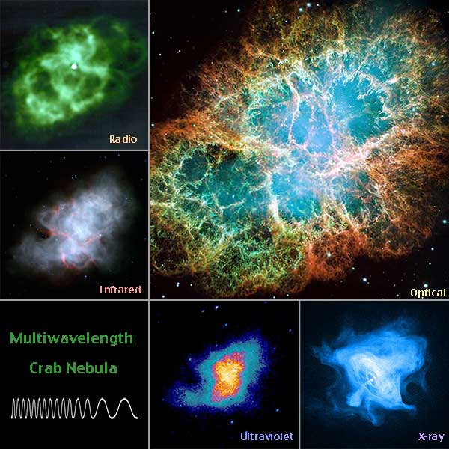
X-RAYS
0
Very short wavelengths, high energies. Penetrates human tissue. Reveals extremely HOT and VIOLENT regions in the universe
Image from: https://imagine.gsfc.nasa.gov/educators/lessons/supernova/

Slide 24
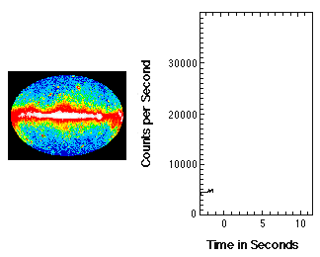
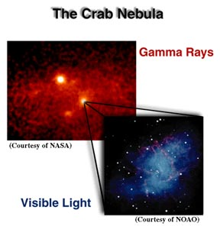
0
GAMMA RAYS
Most energetic; shortest wavelength; go THROUGH just about everything. Crab Nebula/supernova remnant on the left; gamma ray burster on the right.
GIF from: https://science.nasa.gov/science-news/science-at-nasa/2008/11jun_glast2

Slide 25
DISCUSSION QUESTION: When the black holes collided to create the event we observed as GW150914, the amount of energy released exceeded the rest of the observable universe combined. BUT NO ELECTROMAGNETIC RADIATION WAS DETECTED FROM IT. Why not?

Slide 26
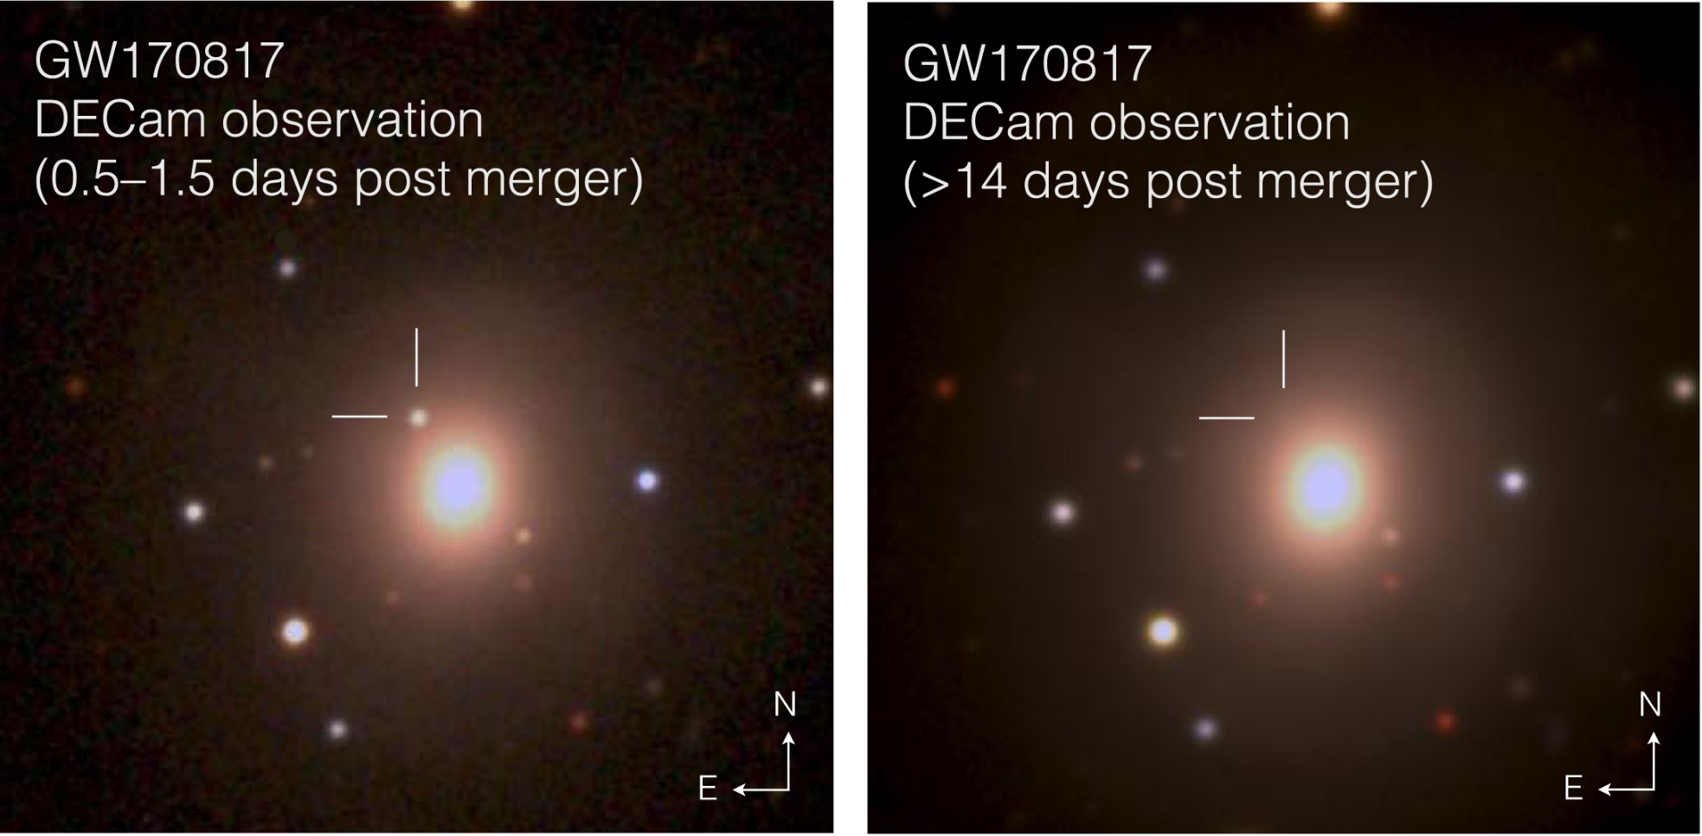
The gravitational wave event GW170817 coincided with this optical observation:
Figure 1 from “The Electromagnetic Counterpart of the Binary Neutron Star Merger LIGO/Virgo GW170817. I. Discovery of the Optical Counterpart Using the Dark Energy Camera,” by M. Soares-Santos et al 2017 ApJL 848 L16

Slide 27
The optical event was determined to have occurred in a galaxy 144 million light years away. IR and UV detections were also made. In addition, a short burst of gamma rays was detected within 2 seconds of the gravitational wave detection.
What does this information tell you about the objects that merged to create GW 170817?
What does this information tell you about the speed of gravitational waves compared to the speed of electromagnetic waves?

